Slide 1
Prefix Resolution
Hung PHAN

Slide 2
Overview
Machine Translation is a potential approach for solving problems in Natural Language and Software Engineering. In Machine Translation (MT) techniques, Neural Machine Translation (NMT) is considered as the newest trend which outperforms the state of the art approach, Statistical Machine Translation (SMT) in Natural Language Translation thanks to its ability to take advantages of Deep Learning. However, prior works show that in problems that the parallel corpus has two special characteristics, the SMT achieved higher accuracy compared to SMT in BLEU score and in word-level accuracy comparison.These two characteristics are the consistent between length of source-target pairs and consistent between order of source tokens and target tokens. In this work, we explore a research problem which has these characteristics, that is how to map from space of prefixes/ abbreviation of words with short sequences of letters appeared in each word to the space of words. We build Machine Translation engines based on SMT and NMT to learn the mapping for words/ code tokens generation from 3 types of corpus: English general text, software documentation and programming language. In these corpus, we analyze the ability of mapping from prefixes in different type of text. We focus our work on the programming language corpus and propose the application of MT in code tokens suggestion from prefix or abbreviation. By the evaluation, we show that the SMT outperforms NMT in this research problem, which provides potential direction to improve the current NMT engines to be optimize in specific classes of parallel corpus. By achieving the accuracy from 65% to 90% for code tokens generation of 1000 Github code corpus, we show the potential of using MT for code completion at token level.

Slide 3
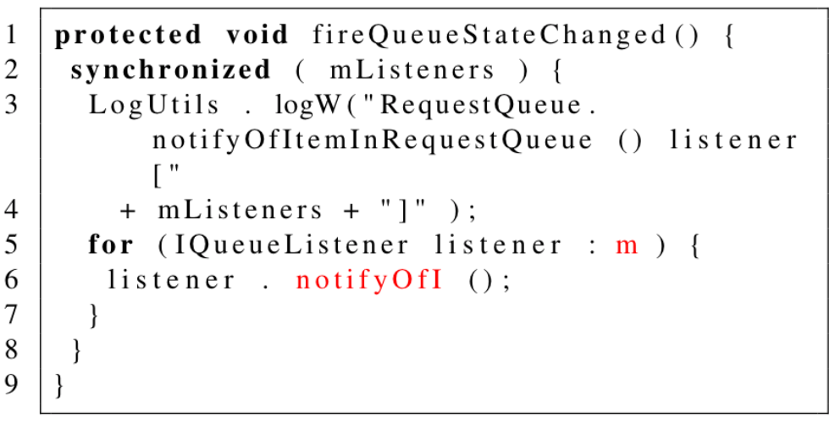
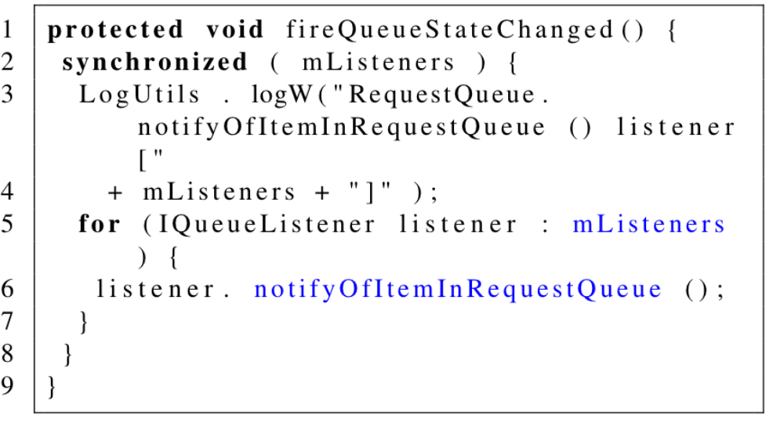
Input & Output
Input
Output
PrefixMapping
Advantages:
Prefix = first letters of code tokens.
Developers only write first letter of tokens to get output.
Suggest all types of code tokens.
Code Editor

Slide 4
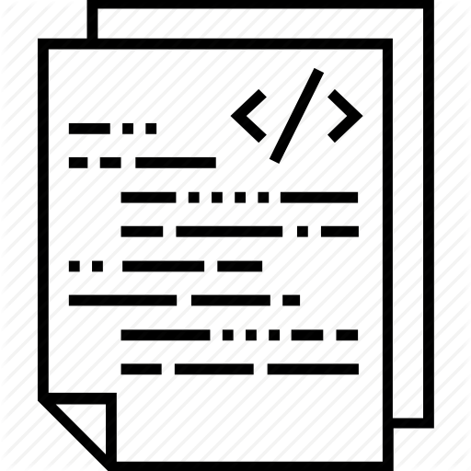
How PrefixMapping works
Training
Source | 1-letter prefix | s ( m ) { L . l ( " ( ) _ + m + " ) ; f ( I l : m ) { l . n ( ) ; } }
 | 5-letters prefix | synch ( mList ) { LogUt . logW ( "Requ ( ) _list + ...
 | 9-letters prefix | synchroni ( mListener ) { LogUtils . logW ( "RequestQ ( ) _listener + ...
Target | Code tokens | synchronized ( mListeners ) { LogUtils . logW ( "RequestQueue.notifyOfItemInRequestQueue ( )...
AST Parser
Code
Repository
Testing
Code
with
prefixes
AST Parser
s ( m ) { L . l ( " ( ) _ + m + " ) ; f ( I l : m ) { l . n ( ) ; } }
Machine Translation
Engines
Complete code
Resolve
Prefix
for ( ISelectionListener listener : mListeners ) {

Slide 5
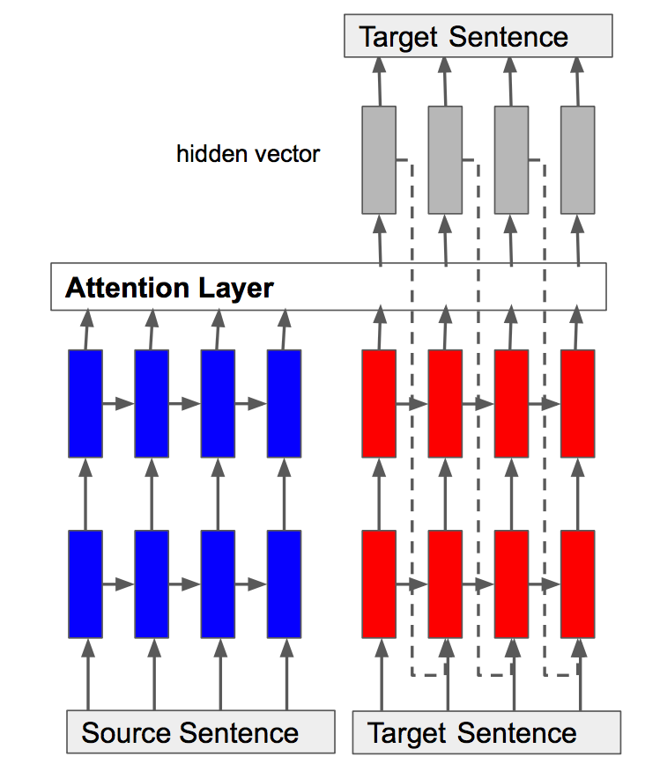
Machine Translation Engines
Statistical Machine Translation | Neural Machine Translation
Precision: 65% (1 letter) to 90% (9-letters) | Precision: 58% (1 letter) to 82% (9-letters)
Language Model
Translation Model

Slide 6
Contributions
Provide a tool of code completion for prefixes in the form of any types of code tokens.
Generalize a class of research problems which Neural Machine Translation outperforms Statistical Machine Translation.
Summarize metrics for evaluating this class of problems using translation.
Analysis on prefix mapping depending on different types of Programming Language elements.

